Slide 1
OMAuto Incubator Report Diagrams
This deck contains the images included in the OMA Auto Incubator Report page on the OMA Wiki
https://wiki.openmobilealliance.org/display/OI/OMA+Report+on+Automotive+Opportunity
Images on Confluence work best as picture files (recommended as PNG) and are linked in the report as such.
To add or update an image in the report
If adding an image, create a new slide in this deck to hold the image in its source format (for Office drawing formats) or the image (PNG) file.
Edit the image using PowerPoint, or if you want to use some other image editing tool (e.g Gliffy) edit the image using that tool and save the new image as a PNG in this deck so we have a single collection of the images.
Title the deck slide per the name of the file you will upload to the wiki. It’s recommended to title the file per the image title in the report.
To upload/update the image:
Save the PowerPoint format image as a PNG to a folder on your computer, or save the PNG format image embedded in the PowerPoint to a folder on your computer.
Edit the wiki page, and use the “Files” tool to upload the image. If you are updating an image with the same name, you don’t need to re-insert it, so deselect the checkbox on the image and select close.

Slide 2
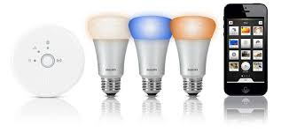
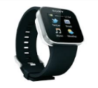
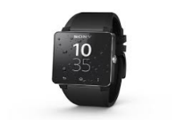
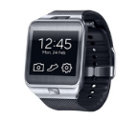
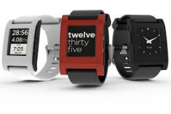
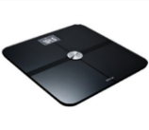
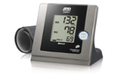
Various External Devices Work with GotAPI and Applications.png
GotAPI：Provides a total framework for applications to access external devices through device APIs using Web technologies
Plug-Ins：Implement device APIs exposing services from external devices to applications through GotAPI
Smartphone
Browser
Web
Apps
Cameras
GotAPI
Toys
Smart Glasses
Plug-Ins
Device API
Sensors
Smart Light
Remote Controls
Healthcare devices

Slide 3
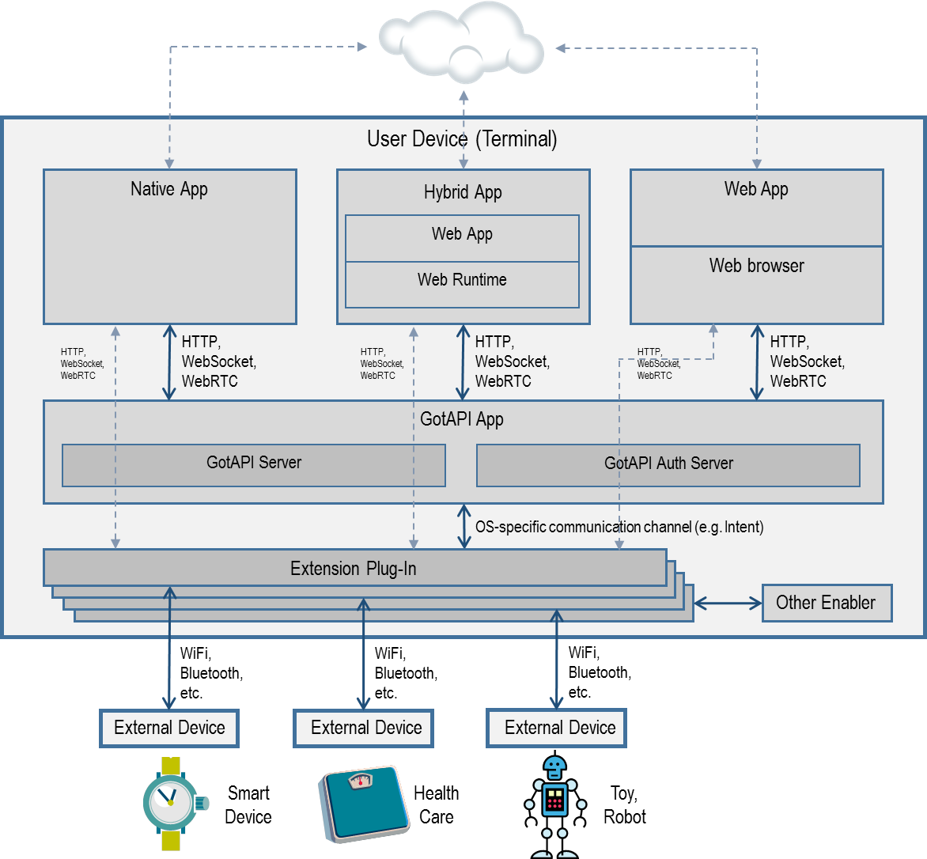
GotAPI.png

Slide 4
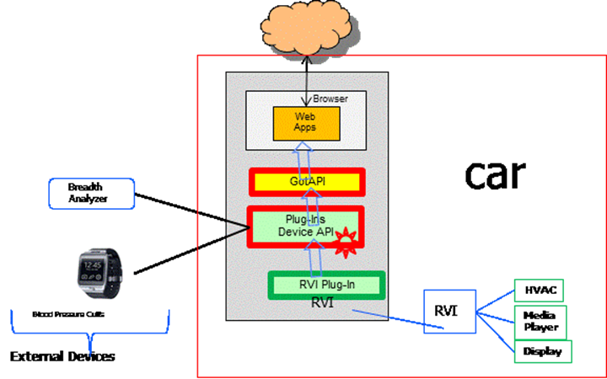
Use Case A.png

Slide 5
Use Case B.png
Car
RVI as Client/App
GotAPI
Device APIs
Device APIs
Watch
External Devices

